Slide 1


Next Word Prediction - Language Model
Tejashri Bhilare
DSC680 - Applied Data Science
April 2025

Slide 2

Business Problem
Delays in customer service chat and email responses.
Representatives struggle with domain knowledge.
Goal: Build a predictive model to suggest next words to speed up process

Slide 3
Background/History
Language modeling predicts next words in sequences.
RNNs (Recurrent Neural Networks) revolutionized NLP.
Customer service efficiency improved with AI-supported communication.

Slide 4

Data Explanation
Source: Relational Strategies in Customer Service (RSiCS) dataset from Kaggle.
Data Prep:
Combined conversation fields.
Text cleaning and tokenization.
Data Dictionary: Greeting, Backstory, Gratitude, Rant, Express Emotion.

Slide 5
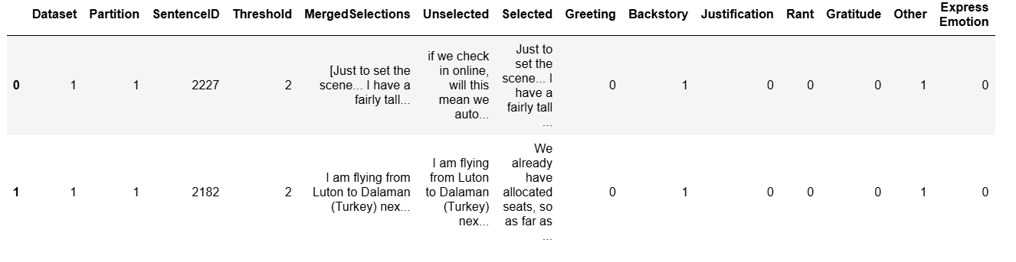

Slide 6
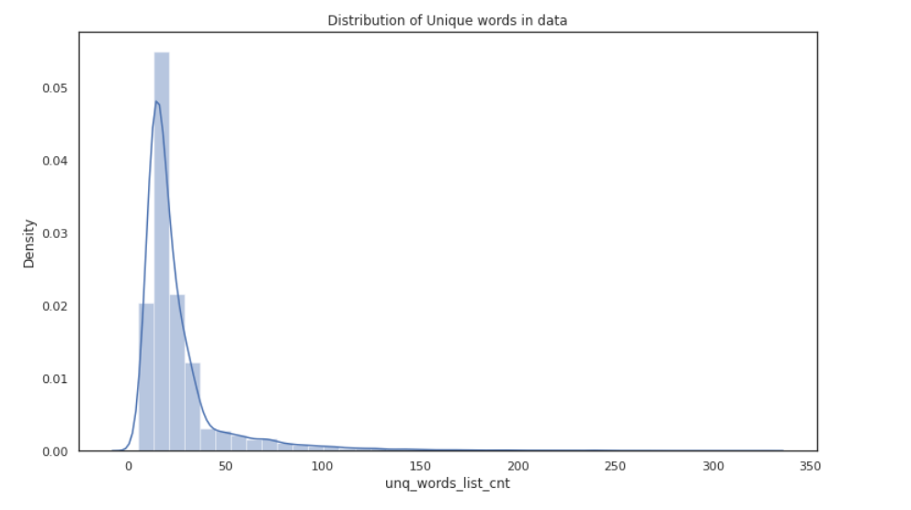

Slide 7
Methods
Followed CRISP-DM framework.
Built LSTM model with TensorFlow/Keras.
Model input: sequences of 10 characters.
Evaluation: Accuracy and Loss monitoring.

Slide 8
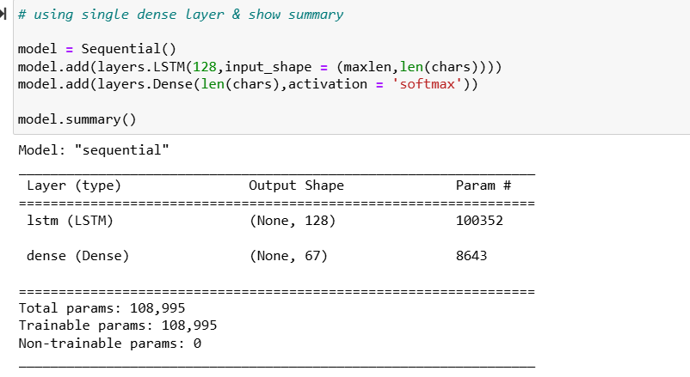

Slide 9
Analysis
Training Accuracy: ~63%
Validation Accuracy: ~61%
Slight overfitting after 15 epochs.
Model effective for customer service text prediction.

Slide 10
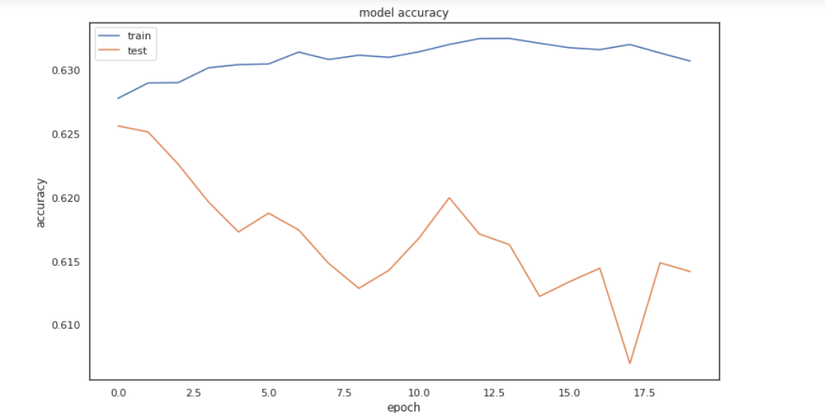
Model Accuracy

Slide 11
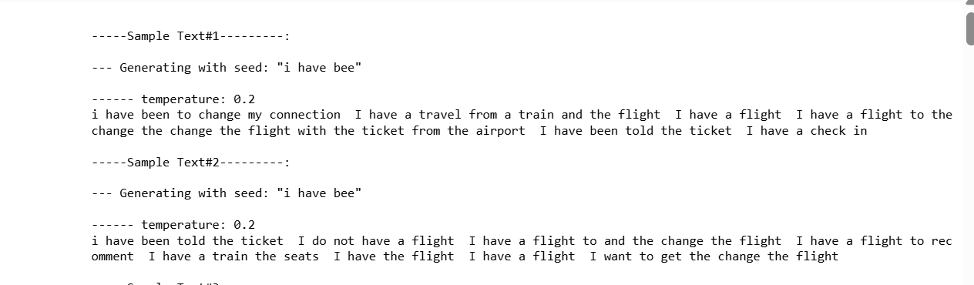

Slide 12
Ethical Assessment
Data Privacy: Anonymized data.
Bias Mitigation: Reviewed dataset.
Responsible AI: Human in control.
Transparency: Agents informed.

Slide 13
Conclusion
Model assists agents to write faster and better responses.
Early signs of success despite minor overfitting.
Real-time next-word prediction achievable.

Slide 14
APA References
Next IT (2016). RSiCS Dataset.
TensorFlow. Recurrent Neural Networks.
Didado, J. Ethics in NLP.
Kaggle. Customer Service Dataset.
Goodfellow et al. Deep Learning Book.

Slide 15
Thank You!

